Slide 1
Infection Prevention and Control (IPC) for Marburg Virus Disease (MVD): Environmental Cleaning & Waste Management for HCWs
Healthcare Settings with Limited to Intermediate Resources
Updated: March 2023
Notes:
Intended Audience: This presentation focuses on what healthcare workers should know about environmental cleaning and disinfection for Marburg virus disease. A different presentation on this topic is available for facilities management personnel at https://www.cdc.gov/vhf/marburg/non-us/global-ipc.html.
Please note that the IPC for MVD topics are published in sequence with the expectation that participants will progress through the series. You may, however, mix and match content to meet participant needs, and in these cases, you may need to adjust the sample script accordingly.
Estimated time with audience participation: Approximately 20-25 minutes
Script:
Welcome! Today we'll be focusing on environmental cleaning and disinfection as well as waste management in the context of Marburg virus disease.

Slide 2
Learning Objectives
After this presentation, participants will be able to
Explain why environmental cleaning is important in the context of MVD.
Describe at least three general principles of environmental cleaning.
Describe 3 common streams for waste in healthcare facilities.
Notes:
Script:
We have three learning objectives for today. By the end of our time together today, you should be able to explain why environmental cleaning is important in the context of MVD, describe at least three general principles of environmental cleaning, and describe 3 common streams for waste in healthcare facilities.

Slide 3
Which is correct?
Cleaning is killing germs. Disinfecting is removing dirt and some germs.
Disinfecting is a type of cleaning (cleaning with chemicals).
Cleaning is a type of disinfecting (disinfecting with soap or detergent).
Cleaning is removing dirt and some germs. Disinfecting is killing germs.
Notes:
Activating background knowledge:
A key benefit of working with adult learners is that they likely already have some knowledge or experience related to the topic you are teaching. Activating background knowledge helps participants connect new learning to what they already know and may help them understand new information better. It also helps you, the instructor, to identify gaps in knowledge where you may need to spend extra time or add emphasis while teaching. Use this slide as an opportunity to let participants share what they already know.
Script:
You clean and disinfect a lot in healthcare, but what’s the difference? There are four statements here about cleaning and disinfecting. Only one is correct. I want you to choose the sentence that best describes cleaning and disinfection. I’ll give you a minute to think before revealing the answer.
[Pause for participants to decide on their answer.]

Slide 4
Answer:
Cleaning is killing germs. Disinfecting is removing dirt and some germs.
Disinfecting is a type of cleaning (cleaning with chemicals).
Cleaning is a type of disinfecting (disinfecting with soap or detergent.
Cleaning is removing dirt and some germs. Disinfecting is killing germs.
Notes:
Script:
The correct answer is the last one: that cleaning removes dust, dirt, and grime, including organic material like blood, and some germs. Disinfection kills germs. We’re going to talk more about cleaning and disinfection today and why they’re so important in the context of MVD.

Slide 5
Environmental Cleaning Overview
Notes:
Script:
Let’s do a quick overview of environmental cleaning: why it’s important and how to do it safety and effectively.

Slide 6
Why Environmental Cleaning?
Marburg virus can live/persist on surfaces (tables, chairs, etc.)
Touching contaminated surfaces or using contaminated equipment can spread Marburg virus to you and your patients.
Appropriate cleaning and disinfection helps prevent the spread of MVD in facilities. This protects
YOU
Your co-workers & patients
Your community
Notes:
Script:
So why is environmental cleaning important? Marburg virus can live on surfaces like tables, chairs, and medical equipment. If you touch contaminated surfaces or use contaminated equipment, you can spread Marburg virus to yourself and your patients. Appropriate cleaning and disinfection helps prevent the spread of MVD in facilities. This protects you, your co-workers, and patients. By keeping yourself safe, you also protect your friends, family, and others you come in contact with in your community.

Slide 7
Definition: Environmental Cleaning
Environmental cleaning is the general term for cleaning and disinfecting the patient care environment.
Cleaning: removes dirt and some germs and is performed with soap and water
Disinfecting: kills germs using chemicals such as 0.5% chlorine solution
Notes:
Script:
Environmental cleaning is the general term used to refer to cleaning and disinfecting the patient care environment. Cleaning removes dirt and some germs and is performed with soap and water. Disinfecting kills germs using chemicals such as 0.5% chlorine solution.

Slide 8
Principles of Environmental Cleaning
Always clean before disinfecting
Organic material left on surfaces decreases effectiveness of disinfectants
Always proceed from the cleanest area to the dirtiest area
Isolation area should always be cleaned last
Always clean in a systematic manner (e.g., clockwise) to avoid missing areas
Always be sure to clean and disinfect patient care equipment between each patient
Where possible, dedicate cleaning supplies in higher risk areas (e.g., delivery, operation room)
Always dedicate cleaning supplies for Marburg virus disease isolation areas
Notes:
Script:
These are some general principles of environmental cleaning. Some of these may sound familiar to you because these principles are not just for cleaning when MVD may be present. They are principles that help to generally prevent healthcare-associated infections of many kinds.
First, always clean before disinfecting. When you clean, you remove organic material left on surfaces. If that organic material isn’t removed, it can decrease the effectiveness of disinfectants. Use soap and water to clean and chlorine to disinfect. This means you will use soap and water first so that chlorine can do its job.
Begin cleaning in the cleanest area and move towards the dirtiest area. Isolation areas should always be cleaned last and preferably should have their own cleaning staff and protocols.
Always clean in a systematic manner (for example, clockwise) to avoid missing areas.
Clean and disinfect patient care equipment between each patient such as stethoscopes or blood pressure monitors.
Finally, where possible, dedicate cleaning supplies in higher risk areas such as the delivery area or the operating room so that they are not used elsewhere. In the case of MVD, always dedicate cleaning supplies for MVD isolation areas so that they’re not used in other patient care areas.

Slide 9
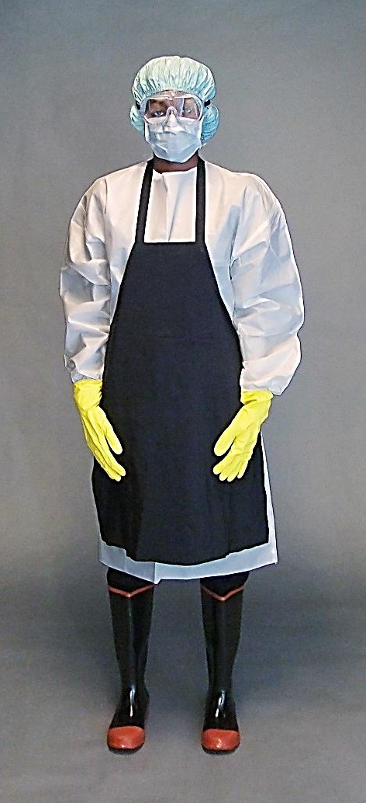
PPE for MVD Environmental Cleaning
Inner gloves (to assist when removing PPE)
Outer gloves (thick, rubber gloves given use of chemicals while cleaning and disinfecting)
Gown or coverall
Apron
Mucous membrane protection (*face mask + face shield) OR (*face mask + goggles)
Rubber boots (or shoe covers)
Head cover
*Respirator can be used in place of face mask (structure of respirator keeps it from collapsing when soaked with sweat; may be preferred in hot, humid climates)
Notes:
Script:
When performing environmental cleaning in the context of MVD, you need to wear appropriate personal protective equipment, also called PPE, to protect yourself from exposure to infectious agents.
You should always wear double gloves: an outer pair of thick, rubber gloves for protection from the chemicals used to clean and disinfect, and an inner pair of gloves to assist when removing PPE. To protect your body, you should wear a gown or coverall and an apron. To protect your eyes, nose, and mouth, you should wear a face mask with a face shield or a face mask with goggles. If you find that your face mask collapses from getting soaked with sweat, you can wear a respirator in place of the face mask. The structure of the respirator will prevent this problem and also provide proper protection.
You should also wear rubber boots or shoe covers and a head cover.
You can learn more about PPE from the PPE-focused sessions for healthcare workers found at the CDC web page: https://www.cdc.gov/vhf/marburg/non-us/global-ipc.html.

Slide 10
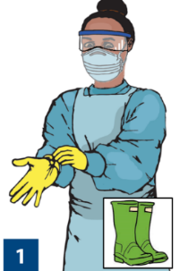
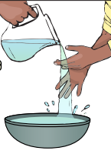
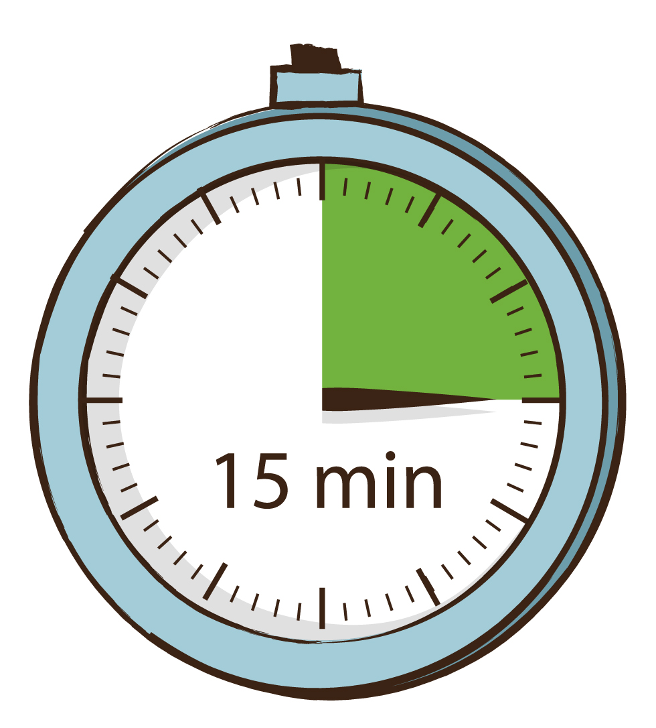
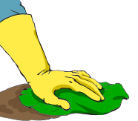
How to Clean Up a Spill of Body Fluids
DO NOT spray disinfectant directly on body fluid spills
Perform hand hygiene
Put on appropriate PPE for the task
Use a cloth or absorbent towel to remove excess liquid
Clean surface with soap and water
Disinfect with 0.5% chlorine solution
Keep the surface wet for at least 15 minutes
Discard waste and remove PPE
Perform hand hygiene
Notes:
Script:
When you need to clean up a spill of body fluids, NEVER spray disinfectant directly on the spill because that can create splashes or make the spill bigger.
Before beginning to clean the spill, always conduct hand hygiene and put on appropriate PPE for the task.
You should begin by using a cloth or absorbent towel to soak up as much of the spill as possible. This cloth or towel should then be discarded into an infectious waste bag.
Then you should clean the area by wiping with a clean cloth soaked in soap and water.
NEVER put a cloth or towel in chlorine or water after use as it is considered highly infectious waste and will contaminate the chlorine solution. Instead, you can use a cup to pour the chlorine solution over your cloth to avoid dipping the cloth itself. After each cloth is used, it should be put into an infectious waste bag for disposal. More than one cloth may be required to clean and disinfect the spill.
After thoroughly cleaning the area to remove all visible contamination, use a clean cloth soaked in 0.5% chlorine solution to disinfect the area. You should make sure that the area stays wet with chlorine for 15 minutes. This may involve using additional cloths and adding more chlorine solution to the surface to keep it wet.
Finally, discard the waste and remove PPE properly. Then, perform hand hygiene.
We will talk more about waste disposal in a little bit. For more details on how to remove PPE and perform hand hygiene, you can review the presentations found at the CDC web page: https://www.cdc.gov/vhf/marburg/non-us/global-ipc.html

Slide 11
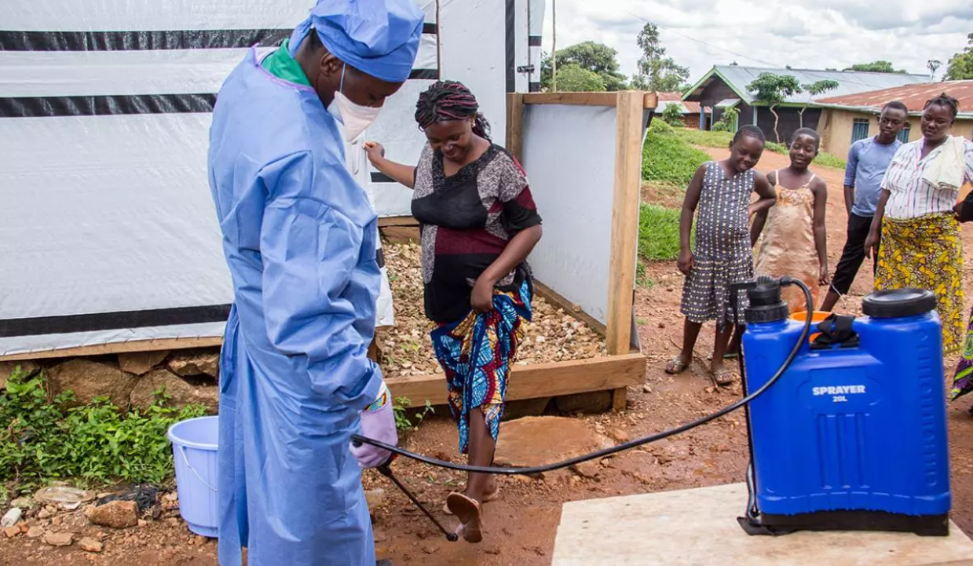
Using Chlorinated Solutions
Use chlorine solution for environmental cleaning in MVD isolation areas
0.5%* for hard/non-porous surfaces (floors, counters, bed rails)
Make sure it stays wet on the surface for 10 minutes
Do NOT spray chlorine
Never spray people
For surfaces, wiping is preferred
https://www.mercycorps.org/blog/ebola-outbreaks-africa-guide/chapter-3
* Alternatives: Alcohol at 70-90% (ethanol, isopropyl), improved hydrogen peroxide ≥ 0.5%
Notes:
Script:
When using chlorine solutions for environmental cleaning in MVD isolation areas, a concentration of 0.5%, sometimes called “strong chlorine”, is needed for hard surfaces such as floors, counters, and bed rails. The contact time of chlorine is 10 minutes. This is how long chlorine needs to be on a surface to kill the microorganisms. The surface should be sufficiently wet for 10 minutes to make sure it’s enough time to disinfect.
Note that WHO suggests that soiled linens be safely disposed of as infectious waste via incineration (as opposed to disinfection or decontamination).
You should never spray chlorine.
You especially never want to spray chlorine on people (direct spraying, disinfectant tunnels, or any other “creative” solutions) because of potential adverse health effects which we’ll discuss on another slide. When cleaning surfaces, wiping is preferred over spraying.
Further reading:
Deliberate exposure of humans to chlorine-the aftermath of Ebola in West Africa - PubMed (nih.gov) - https://pubmed.ncbi.nlm.nih.gov/27895903/

Slide 12
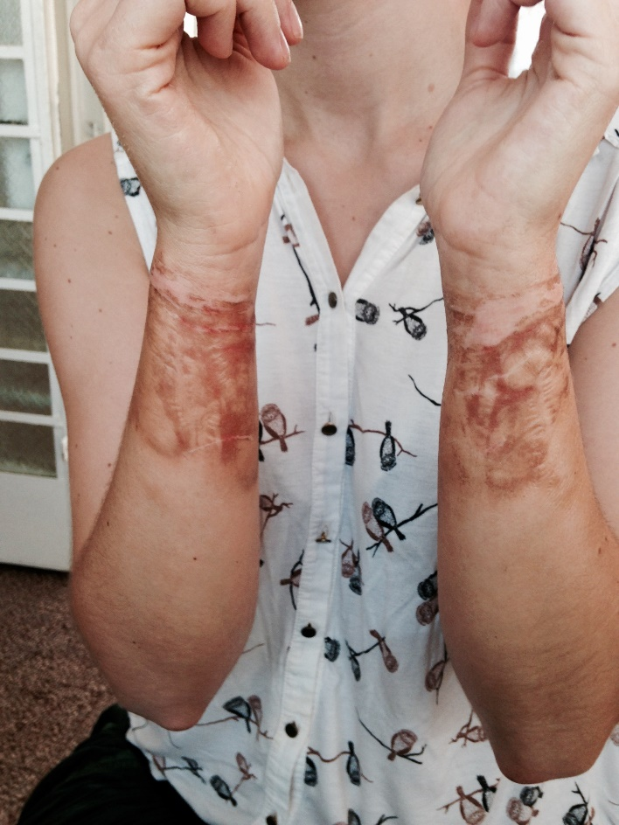
Chlorine—A Word of Caution
Adverse health effects
Respiratory problems
Burns
Potentially explosive when mixed
Calcium hypochlorite + sodium dichloroisocyanurate = potential explosion
Potential for creating toxic gases when mixed with ammonia or other cleaning products
Eye, nose, and throat irritation and other severe reactions
Chlorine burn from dunking hands with gloves on in bucket –unknown concentration in bucket (Sierra Leone 2014 Ebola Virus Disease outbreak)
Notes:
Script:
Chlorine can cause adverse health effects including respiratory problems and burns when handled without the proper PPE. This picture shows a chlorine burn from dunking hands in a bucket of chlorine. The concentration was unknown, and by the time this person could get the rest of her PPE off safely, about 10 minutes, she had chlorine burns on her arms.
Chlorine is also potentially explosive. Calcium hypochlorite may be combustible when mixed with some other types of powdered chlorine. At an Ebola treatment unit during an Ebola outbreak in West Africa, an explosion happened in a chlorine mixing area, which had two separate types of chlorine present: HTH Granular (Calcium Hypochlorite) and SDIC Powder (Sodium Dichloroisocyanurate). The blast was strong enough to be heard several hundred meters away, scattered chlorine powder around a wide area, and blew out a nearby tarpaulin wall.
Finally, if chlorine is mixed with any other disinfectants or cleaning products, particularly acids and ammonia based products, there is the potential for the creation of toxic gases, which can cause eye, nose, and throat irritation and other severe reactions.
In sum, always use caution when using chlorine.

Slide 13
Waste Management
Notes:
Script:
Part of keeping a healthcare facility clean is disposing of waste properly, so now we’ll talk a bit about the process of waste management and your role in it.

Slide 14
Waste management includes:
storing waste
treating waste
disposing of waste
sorting/segregating waste
collecting waste
transporting waste
Safe management of waste generated during patient care is the responsibility of all staff.
Notes:
Script:
The waste management process at healthcare facilities includes several steps:
Sorting or segregating waste
Collecting waste
Transporting waste after it’s collected
Potentially storing waste
Any needed treatment of waste
And final disposal of waste.
Safe management of waste generated during patient care is the responsibility of all staff.

Slide 15
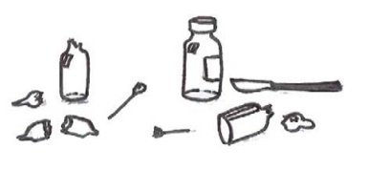
Why Waste Management?
Healthcare facilities are responsible for managing waste.
Inappropriate waste management poses potential health risks to you, your patients, and your co-workers, as well as to your community.
Notes:
Script:
Healthcare facilities are responsible for managing waste, whether it’s handled on site or whether there’s a contracted company. Inappropriate waste management poses potential health risks to you, your patients, and other staff in your facility, as well as to your community.
Potential risks might include exposure to items contaminated with Marburg virus, such as contaminated gloves, or exposure to sharp items such as used needles that pose a risk of physical injury as well as exposure to Marburg virus.

Slide 16
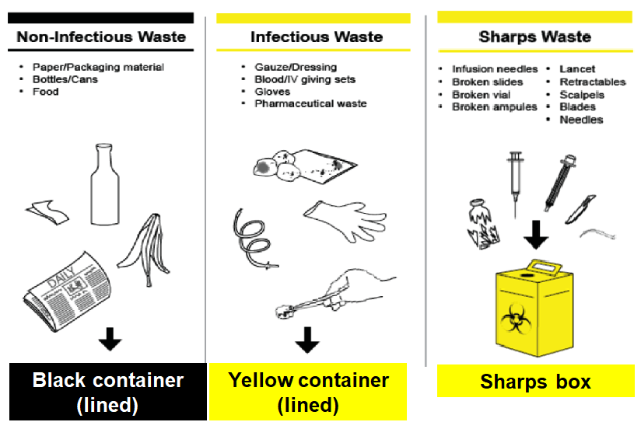
Waste Segregation (1)
3-bin system
(most common)
Other waste streams
(less common)
https://www.washinhcf.org/resource/wash-fit-training-package/
Notes:
Script:
Waste segregation, also called waste sorting, involves disposing of waste in the correct waste receptacles. Waste segregation is the responsibility of all staff. Medical facility waste is typically sorted by a 3-bin system that includes non-infectious waste, infectious waste, and sharps waste. As you do your job, you should dispose of waste in the appropriate waste bins.

Slide 17
Waste Segregation (2)
3-bin system
(most common)
Other waste streams
(less common)
https://www.washinhcf.org/resource/wash-fit-training-package/
Notes:
Script:
Household and general waste should go in one container. This type of waste is non-infectious and includes packaging, food scraps, newspapers, plastic containers, and bottles. These bins are typically black.

Slide 18
Waste Segregation (3)
3-bin system
(most common)
Other waste streams
(less common)
https://www.washinhcf.org/resource/wash-fit-training-package/
Notes:
Script:
Infectious waste that does NOT include sharps should go in another bin. This type of waste is known or suspected to contain pathogens and presents a risk of disease transmission. Examples include
Gloves,
Highly infectious waste such as laboratory cultures and microbiological stocks,
Waste and wastewater contaminated with blood and other body fluids or excreta
And materials that have been in contact with patients infected with highly infectious diseases in isolated rooms
These bins are typically yellow. A bucket should also be available for infected liquids and fluids.

Slide 19
Waste Segregation (4)
3-bin system
(most common)
Other waste streams
(less common)
https://www.washinhcf.org/resource/wash-fit-training-package/
Notes:
Script:
Finally, sharps should be disposed of in a different container. Sharps waste includes used or unused sharp objects, including:
Needles and syringes
Infusion sets
Scalpels
Pipettes
Knives
Blades
And broken glass.
We focused on sharps safety in a previous presentation. If you’d like more information on sharps safety, you can go back and review that presentation at the related CDC web page: https://www.cdc.gov/vhf/marburg/non-us/global-ipc.html

Slide 20
Waste Segregation (5)
3-bin system
(most common)
Other waste streams
(less common)
https://www.washinhcf.org/resource/wash-fit-training-package/
Notes:
Script:
Some facilities may need other kinds of waste collection containers such as containers for pathological waste (organic or anatomical), chemical and pharmaceutical waste, and radioactive waste. These types of waste are disposed of in a garbage can or bucket that is most commonly either red or yellow, but may also be brown.
They should be clearly labeled with the type of waste they contain. Typically, pathological waste can be disposed of on-site in a dedicated pit (such as a placenta pit). Less common chemical and radioactive waste, if produced, should be managed in close coordination with Ministry of Health to determine appropriate disposal procedures; these may involve centralized collection.
For more details about managing waste, check out the presentation for healthcare facility managers found at the related CDC web page: https://www.cdc.gov/vhf/marburg/non-us/global-ipc.html

Slide 21
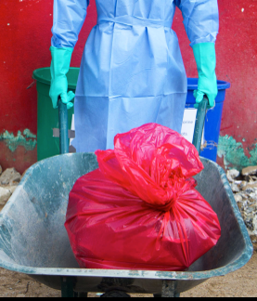
Collecting and Transporting Waste
Waste bags should be collected on a regular schedule or when bin is 2/3 full
Wear appropriate PPE (heavy duty gloves, gown or coveralls, face mask, eye protection, foot covers or boots) when handling contaminated waste
Transport the waste in a cart or wheelbarrow from place of segregation to place of storage or disposal
Follow a designated transportation route
Notes:
Script:
Each separate waste bag will need to be collected. Waste bags should be collected on a regular schedule or when a bin is 2/3 full, whichever comes first, so that waste isn’t over-flowing out of bins. The waste will then need to be transported to areas of waste storage and disposal.
In the context of MVD, if it is your job to collect, transport, treat, or dispose of waste, you must wear appropriate PPE during the process to keep yourself safe. Appropriate PPE includes heavy duty gloves, gown or coveralls, face mask, eye protection, and foot covers or boots. (If you’d like more information on what PPE you need and how to put it on, check out the presentation on putting on and taking off PPE found at the related CDC web page: https://www.cdc.gov/vhf/marburg/non-us/global-ipc.html
Waste should be transported in a cart or wheelbarrow from the place of segregation, that is, the waste bins, buckets, and boxes, to the place of storage or disposal. By transporting in a cart or wheelbarrow, if you have sharps in some of the bags, those bags aren’t up against your body which could lead to sharps injuries. Notice that in this picture, the person isn’t carrying the bag of waste but is transporting it in a wheelbarrow.
It is also recommended to have a planned transportation route that you follow when collecting waste to avoid any exposure to staff, patients, and the public.

Slide 22
Waste Disposal
Healthcare facilities must have a functional system for the final disposal of waste
Infectious and potentially infectious waste must be:
Incinerated
OR
Treated with a non-burn treatment (autoclaving/grinding or other alternative treatment) before being placed in regular waste stream
OR
Buried
Notes:
Script:
Every facility must have a functional device for the final disposal of waste including an incinerator with ash pit or a non-burn system such as an autoclaving and grinding process for infectious waste. If infectious waste is autoclaved and grinded, it can be then added to the regular waste stream for landfill disposal.
In some very low-resource settings, a temporary burning pit may also be an option for treating and then burying infectious waste on-site while longer term improvements are being made. It is also common to have a placenta or organic waste pit on site, as other methods of treatment for these may not be culturally acceptable.

Slide 23
Reflection
Based on what you learned today, will you do anything differently when performing environmental cleaning or disposing of waste in your healthcare facility?
Notes:
Reflection:
Encourages participants to apply, analyze, and/or evaluate what they have learned, which helps them to deepen their understanding of the topic
Allows participants to think about how they’re new learning applies to their previous knowledge or experiences, which helps them better understand and remember the ideas taught
Allows you to check participants’ comprehension of what has been discussed to see if any topics need to be reviewed
Script:
Now that we’ve spent some time talking about environmental cleaning and waste management, I’d like you to think about your specific job duties. Based on what you learned today, will you do anything differently when performing environmental cleaning or disposing of waste in your healthcare facility in the context of MVD?
Take a minute to write down or think about one or two things that you might do differently based on what you learned today.
[Give participants 1-2 minutes to write down their ideas. After participants are finished, you may ask for volunteers to share their answers, but as this is a personal question, and some might feel embarrassed about what they feel they weren’t doing properly in the past, don’t require anyone to answer in front of the group.}

Slide 24
Key Takeaways
Because MVD can live on surfaces, it’s important to keep the healthcare environment clean and dispose of waste properly to keep yourself, your co-workers and patients, and your community safe.
You should always clean before disinfecting to remove organic material left on surfaces that can prevent disinfectants from working well.
All facility employees play a role in waste management. Always dispose of waste in the proper bin.
Notes:
Script:
To wrap up, here some key things I hope you take away from our time today:
First, because MVD can live on surfaces, it’s important to keep the healthcare environment clean and dispose of waste properly to keep yourself, your co-workers and patients, and your community safe.
Remember that you should always clean before disinfecting to remove organic material left on surfaces that can prevent disinfectants from working well.
Finally, all facility employees play a role in waste management. Always dispose of waste in the proper bin.

Slide 25
Thank you!

