Slide 1




Investigating Influenza
Notes:
Influenza is an infectious disease commonly known as the flu. Seasonal outbreaks of influenza occur annually across the globe, leading to the deaths of tens of thousands of people. Additionally, severe outbreaks of pandemic influenza throughout history have caused the deaths of millions.
Note: These slides are made possible by the David J. Sencer CDC Museum Public Health Academy. https://www.cdc.gov/museum/education/lessons/

Slide 2
Terms to Know
 | an increase in the number of cases of a disease above what is normally expected
 | science of protecting and improving the health of people and their communities
 | a preparation that provides a trigger to help the immune system build immunity
 | in a research study, the group that does not receive interventions
 | in a research study, the group that receives interventions to measure effectiveness
 | ongoing, systematic collection, analysis, and interpretation of health-related data
 | type of microbe that causes infectious diseases
Word Bank
Control group
Epidemic
Experimental
group
Public health
Surveillance
Vaccine
Virus
Notes:
Terms to Know:
Control Group - in a research study, the group that does not receive interventions
Epidemic - an increase in the number of cases of a disease above what is normally expected in that population in that area
Experimental group - in a research study, the group that does receive interventions to measure their effectiveness
Public Health - science of protecting and improving the health of people and their communities
Surveillance - ongoing, systematic collection, analysis, and interpretation of health-related data
Vaccine - a preparation that provides a trigger to help the immune system build immunity to a disease; allows the immune system to recognize a virus or bacterium as a threat
Virus - type of microbe (organisms too small to be visible to the naked eye) that causes infectious diseases; has a core of genetic material but no way to reproduce on its own; uses infected cells’ reproductive machinery

Slide 3
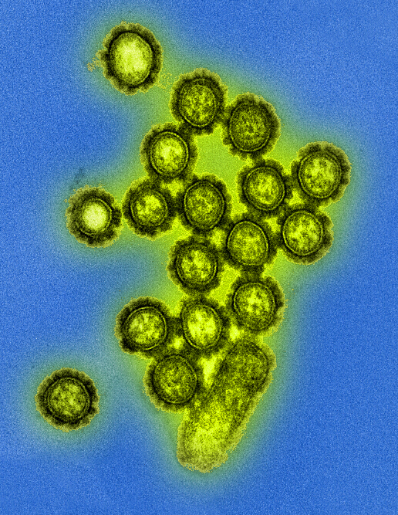
Understanding Flu
Influenza (flu) is a contagious respiratory illness
  Caused by influenza viruses
  Spread by tiny droplets made while coughing, sneezing, or talking or by touching surfaces that have flu virus on them
About 8% of U.S. gets sick from flu annually
Influenza virus particles (digitally colorized transmission electron microscopic image)
Notes:
What is Influenza?
Influenza (flu) is a contagious respiratory illness caused by influenza viruses that infect the nose, throat, and lungs. There are two main types of influenza viruses that cause epidemics: types A and B. These viruses that routinely spread in people (human influenza viruses) are responsible for seasonal flu epidemics each year. About 8% of the U.S. population gets sick from flu each season.
Most experts believe that flu viruses spread mainly by tiny droplets made when people with flu cough, sneeze or talk. These droplets can land in the mouths or noses of people who are nearby. Less often, a person might get flu by touching a surface or object that has flu virus on it and then touching their own mouth, nose or possibly their eyes.

Slide 4

Think About It
Do you or any of your family members get a yearly flu vaccine? Why or why not?
Have you ever had the flu? How did it feel? Note: The “stomach flu” isn’t a flu! It’s a type of unrelated gastrointestinal illness.
Do you think having the flu is a big deal? Why or why not?

Slide 5
Influenza and CDC
Viruses are surrounded by a protein coat called a capsid
Influenza viruses have surface proteins called hemagglutinin and neuraminidase that allow them to attach to host’s cell membranes
Antibodies use the surface proteins of viruses to recognize and fight infections
Viruses cannot reproduce without using the host’s cell machinery
There are four types of influenza viruses: A, B, C, and D, but most human cases are from types A and B
Many animals can carry influenza
Notes:
Influenza and the Centers for Disease Control and Prevention (CDC)
At the simplest level, viruses are made of nuclear material like RNA or DNA that is surrounded by a protein coat called a capsid. They come in shapes like helical, spherical, icosahedral, and complex. Viruses are incredibly small and can be viewed only by specialized high power electron microscopes. The image below shows the different features of a generic influenza virus.
Influenza viruses are spherical and contain surface proteins that allow them to attach to areas on the cell membranes of their hosts. One type of influenza surface protein is hemagglutinin (HA), pictured here in blue. There are 18 different hemagglutinin subtypes, named H1 through H18. Another surface protein is neuraminidase (NA), pictured here in red. There are 11 different neuraminidase subtypes named N1 through N11.
Following influenza infection or receipt of the influenza vaccine, the body’s immune system develops antiibodies that recognize and attach to antigenic sites, which are regions found on the surface proteins. By binding to these antigenic sites, antibodies neutralize flu viruses, which prevents them from causing further infection.
The M2 ion channels, pictured in purple, allow materials and signaling molecules to move in and out of the capsid. The ribonucleoprotein complex (RNP), in green, is the genetic material of the influenza virus that provides the information that will be replicated by the host’s cells.
Types of Influenza Viruses
There are four types of influenza viruses: A, B, C, and D. Only types A and B cause flu epidemics.
Influenza A viruses are divided into subtypes based on two antigen proteins on the surface of the virus: hemagglutinin (H) and neuraminidase (N). Current subtypes of influenza A viruses that routinely circulate in people include H1N1 and H3N2.
Influenza B viruses are not divided into subtypes, but instead are further classified into two lineages: B/Yamagata and B/Victoria. Influenza B viruses generally change more slowly than influenza A viruses do. Influenza surveillance data from recent years shows co-circulation of influenza B viruses from both lineages in the United States and around the world.
Influenza C viruses are rarely reported as a cause of human illness.
Influenza D viruses primarily affect cattle and are not known to cause illness in people.
Influenza viruses are found in many different animals, including ducks, chickens, pigs, whales, horses, seals, bats, dogs, and cats. Infectious particles in saliva, mucus, and droppings can spread the virus from animal to animal. While most variants are not transmitted from these animals to people, there are documented outbreaks of certain avian and swine flus in people. When an infectious agent is transmitted from other animals to humans, this is known as a zoonotic infection. This can happen when the virus particles are in the air or when a person touches something that has the virus on it and then touches their nose, eyes, or mouth. Transmission between species is cause for concern due to the possibility it will cause an influenza pandemic.

Slide 6
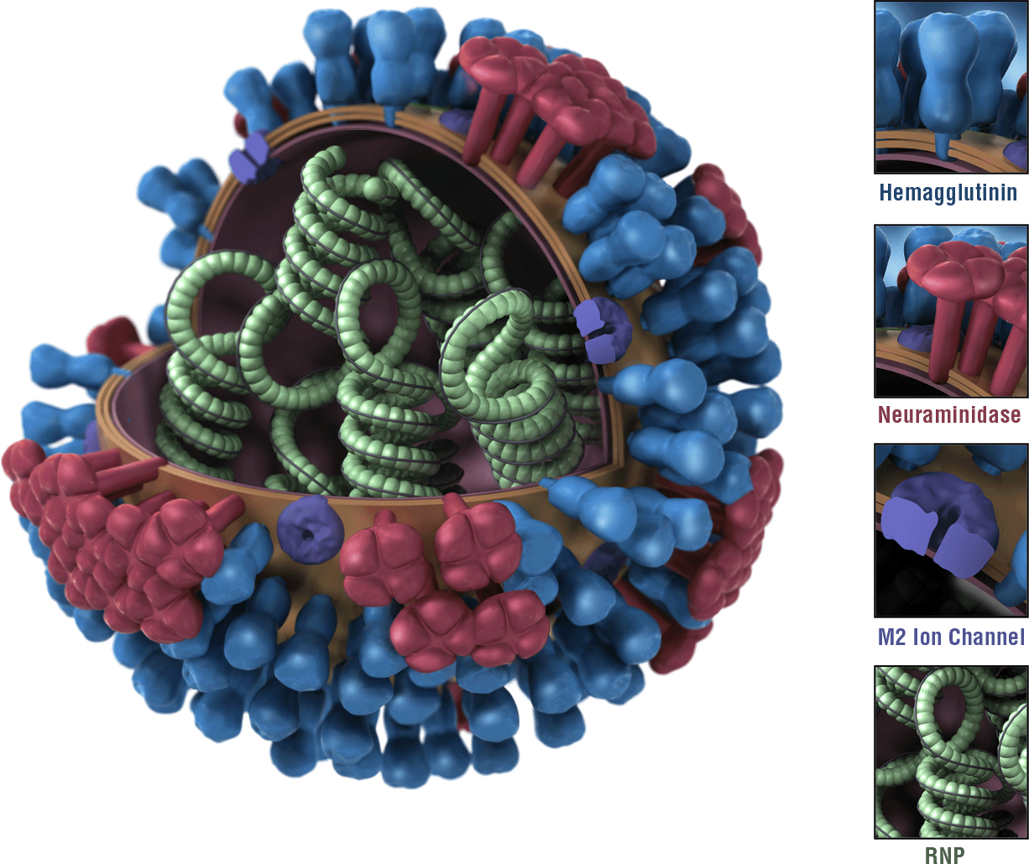
Influenza and CDC
Hemagglutinin
18 different types
(are named H1-H18)
Neuraminidase
11 different types
(are named N1-N11)
M2 Ion Channels
Allow materials to pass through the capsid
RNP (Ribonucleoprotein complex)
Genetic material of the virus
Note: virus capsid is cut open in this image to show the RNP inside
Notes:
Influenza and the Centers for Disease Control and Prevention (CDC)
At the simplest level, viruses are made of nuclear material like RNA or DNA that is surrounded by a protein coat called a capsid. They come in shapes like helical, spherical, icosahedral, and complex. Viruses are incredibly small and can be viewed only by specialized high power electron microscopes. The image below shows the different features of a generic influenza virus.
Influenza viruses are spherical and contain surface proteins that allow them to attach to areas on the cell membranes of their hosts. One type of influenza surface protein is hemagglutinin (HA), pictured here in blue. There are 18 different hemagglutinin subtypes, named H1 through H18. Another surface protein is neuraminidase (NA), pictured here in red. There are 11 different neuraminidase subtypes named N1 through N11.
Following influenza infection or receipt of the influenza vaccine, the body’s immune system develops antibodies that recognize and attach to antigenic sites, which are regions found on the surface proteins. By binding to these antigenic sites, antibodies neutralize flu viruses, which prevents them from causing further infection.
The M2 ion channels, pictured in purple, allow materials and signaling molecules to move in and out of the capsid. The ribonucleoprotein complex (RNP), in green, is the genetic material of the influenza virus that provides the information that will be replicated by the host’s cells.

Slide 7

Influenza and CDC
Disease surveillance requires regular
monitoring of cases to monitor case
numbers, trends, and variants
Global Influenza Surveillance & Response System (GIRS) monitors flu cases globally
Viruses mutate and change over time, so gene sequencing is an important part of surveillance to detect any new variants
  Antigenic drift – small changes to flu viruses
  Antigenic shift – major changes to flu strains, usually from recombination of existing strains through cross-species transfer (example: from birds to people)
Novel flu strains (new variants) carry a risk of causing a pandemic and are monitored carefully
Notes:
Monitoring Influenza
The Global Influenza Surveillance and Response System (GISRS) was established by the World Health Organization (WHO) in 1952 to monitor influenza cases, trends, and variants. CDC’s Influenza Division has worked with WHO since 1956 to help control seasonal and pandemic influenza. CDC also helps establish and maintain surveillance and laboratory capacity in more than 50 countries around the world. CDC’s FluView is a weekly influenza surveillance report that provides up-to-date information, including interactive data visualization tools, to monitor U.S. flu cases and deaths.
An important aspect of influenza surveillance is the use of gene sequencing to identify currently circulating strains of influenza, particularly any novel strains. Viruses mutate over time as small changes occur in the genes. These changes often result in changes to the surface proteins of the virus. When these antigen proteins change, it is known as antigenic drift and usually results in minor changes to the surface proteins. A person’s immunity to one strain of flu virus will usually extend to other similar flu viruses and provide cross-protection. However, the small changes due to antigenic drift over time ultimately produces viruses that are substantially different from previous strains. All types of influenza exhibit antigenic drift. This is one reason why the composition of the flu vaccine must change yearly to match viruses that are currently in circulation.
Antigenic shift is another type of change that is far more abrupt and serious, potentially resulting in novel flu subtypes. This occurred in 2009 when an H1N1 flu virus resulted from the merger of different genes from North American swine, Eurasian swine, humans, and birds. Because it was a novel strain, it spread quickly due to the lack of immunity in the population. Only type A influenza viruses demonstrate antigenic shift, which is why these infections are closely monitored.

Slide 8
Think About It
Why is antigenic shift potentially much more dangerous than antigenic drift?
Novel influenza viruses (viruses different from those currently in circulation) must be reported immediately to CDC. Why do you think this requirement exists?
Use HHMI’s Virus Explorer to examine the characteristics of common viruses. What do you notice about the sizes, shapes, and structures of the viruses shown?
Link to HHMI Virus Explorer

Slide 9

From the Expert
https://youtu.be/f86mImyhaoc
Notes:
From the Expert:
Influenza (flu) is a potentially serious disease that can lead to hospitalization and sometimes even death. Every flu season is different, and influenza can affect people differently, but millions of people get flu every year, hundreds of thousands of people are hospitalized and thousands to tens of thousands of people die from flu-related causes every year. Flu can mean a few days of feeling bad and missing work or it can result in more serious illness. Complications of flu can include bacterial pneumonia, ear infections, sinus infections and worsening of chronic medical conditions, such as congestive heart failure, asthma, or diabetes.
Watch this video to hear Dr. Joe Bresee with CDC's Influenza Division addresses common questions and misconceptions about the flu and the flu vaccine. https://youtu.be/f86mImyhaoc
Why Participate? A Message from CDC
An annual seasonal flu vaccine is the best way to help protect against flu. Vaccination has been shown to have many benefits, including reducing the risk of flu illnesses, hospitalizations and even the risk of flu-related death in children. While some people who get a flu vaccine may still get sick, flu vaccination has been shown in several studies to reduce severity of illness. Everyone 6 months of age and older should get an influenza vaccine every season, with rare exceptions.
You can help your community by getting an annual flu vaccine and talking to others about getting vaccinated. Even if you are a healthy young person who is not worried about facing serious flu complications, vaccination can benefit you by helping to prevent the spread of illness to people in your life who are more vulnerable to serious illness or death.

Slide 10
Think About It
Many flu-related deaths occur because of secondary pneumonia infections that occur in weakened or damaged lungs. How can vaccines help prevent this?
A high dose vaccine containing 4 times the flu virus antigen is generally given to adults 65 and older. What effect do you think this has on the immune system? Why is this recommended for older adults?
Do you think you should wear a mask when sick to prevent spreading flu? Explain.

Slide 11
Give it a Try
Call to Action!
Investigate common myths around influenza.
Analyze influenza data.
Share your findings.
Why do you think participation is important?
Notes:
Call to Action
In order to understand the dangers associated with influenza, it is essential that people understand the difference between preconceptions about influenza and the realities shown in the data. You can help people by following these three steps:
Investigate common myths around influenza. Myths about the flu and flu vaccines persist in today’s world. Choose one you’ve heard before and design an experiment that would allow you to investigate whether there is any truth to it.
Analyze influenza data. CDC collects and publishes influenza data weekly. Use data provided to analyze trends in influenza cases, hospitalizations, and death. Make recommendations to help people in your community avoid the flu.
Share your findings. One of the ways CDC communicates information is through social media. Your explorations can help CDC communicate the work they have done and are doing to decrease influenza cases, hospitalizations, and deaths worldwide.

Slide 12
Use the Scientific Method
Ask
Ask a question
Research
Do background research
Hypothesis
Construct hypothesis
Test
Test with an experiment
Analyze
Analyze data
Draw conclusions
Conclusions
Share
Communicate results
Ask
Ask a question
Research
Do background research
Hypothesis
Construct hypothesis
Test
Test with an experiment
Analyze
Analyze data
Conclusions
Draw conclusions
Share
Communicate results

Slide 13
Give it a Try
1. Investigate common myths around influenza.
Brainstorm myths you’ve heard
about influenza (flu).
Learn about how to set up research studies.
Choose one to investigate.
Design an experiment using the scientific method that would
Notes:
Investigate Common Myths Around Influenza
Up until around 1890, the predominant belief was that diseases were caused by “bad air” stemming from pollution and rotting organic matter. This was known as the miasma theory. Though many scientists over the centuries had theorized that diseases were caused by invisible particles and could spread from person to person, it wasn’t until the mid-19th century that the current germ theory began to take hold. Physician John Snow proposed that cholera was made of cellular units and solved an 1854 London cholera outbreak by blocking a contaminated water pump. In the 1860s, Louis Pasteur conducted experiments proving that bacteria were present in the air. Shortly thereafter, Robert Koch demonstrated that diseases are caused by specific microorganisms. Joseph Lister imposed sanitation requirements for surgeries and hospitals, resulting in dramatically lower rates of infection and death. The idea that diseases were caused by germs took hold, forever changing the face of public health and medicine.
It goes without saying that in the centuries leading up to the development of germ theory, incorrect ideas about the causes and cures of disease were plentiful. “Old wives’ tales” represent the oral tradition by which home remedies and superstitions were transmitted through communities and generations. Though many of these tales have no basis in fact, they provided people with a sense of control in situations where they had none. Many of those false ideas persist today, despite plenty of evidence to the contrary. In this activity, you will be thinking about some of the things you’ve heard about sickness, including causes, treatments, and cures.
What myths, sayings, or old wives’ tales have you heard about the flu?
Here are some examples to get you started:
Feed a fever; starve a cold.
If you’re outside in the cold for too long, you’ll get sick.
Don’t drink milk if you’re sick.
A flu shot can give you the flu.
How do you feel about these? Is there any truth to any of these wives’ tales? Why do they persist?
Design an Experiment
Choose one of your myths to investigate. You may also choose one of the given examples if it inspires you! If you were going to attempt to prove or disprove this statement, how would you do it? Before you get into this task, here is some information about experimental design.
When designing an experiment, it is important that you have a control group and an experimental group. The experimental group will receive whatever treatment or variable is being tested in the experiment, but the control group will not. By examining the different outcomes of the two groups, researchers can then determine whether a treatment is effective or not. Experiments can be conducted as single-blind experiments where the test subjects do not know which group they are in, but the researchers do. A better model is a double-blind experiment where the groups are hidden from both the test subjects and the researchers who are directly conducting the tests. Researchers who know what groups subjects are in might unconsciously give clues to subjects that impact their perception and outcomes, so using a double-blind model helps eliminate that bias.
As you design your experiment, it may be helpful to focus on your independent and dependent variables. An independent variable, sometimes called a manipulated variable, is the thing you will be changing. The dependent variable, sometimes called a responding variable, is the thing you will be measuring or observing to look for a change.
Here is a simple example of how these principles are used to design an experiment investigating treatments for influenza. If you are investigating the claim that vitamin C helps you recover from flu faster, you cannot simply give everyone vitamin C and note that they all got better. It could be that all participants would have gotten better in the same time frame regardless of whether they received the vitamin C or not. Instead, you would need two groups: a vitamin C group (experimental) and a placebo group (control). Both groups would receive doses of a substance they believe is vitamin C, but only one group would actually get the vitamin. The other would get an inactive placebo pill usually made of starch or sugar. The test subjects should have no idea which they are receiving. In a single-blind experiment, the people handing out the pills would know whether they were vitamin C or placebo, but in a double-blind experiment they would not. If the vitamin C group showed a faster recovery, it could indicate that taking vitamin C helps to decrease duration of illness. If both groups fared the same, it likely has no effect. Having the two groups allows for the effects of vitamin C to be better isolated and compared.
Example Experiment
Carrying forward with the same vitamin C experiment, here is what the general experimental design would look like:
Ask a question: How does vitamin C affect the duration of flu symptoms?
Do background research: What is vitamin C? How does it affect the immune system? How much vitamin C is recommended? What are the safety considerations with using vitamin C? What do current studies about vitamin C indicate as far as its effectiveness in helping to fight disease?
Construct a hypothesis: If flu patients are given 500 mg daily vitamin C doses, the duration of flu infection will decrease. The independent variable in this experiment is whether or not a person is given vitamin C, while the dependent variable is how long their flu lasts.
Test with an experiment: Find a population of people with influenza through a health clinic or doctor’s office. Provide patients with vitamin C or a placebo using a double-blind experimental model. Have patients record symptoms and temperature readings every 24 hours for 10 days.
Analyze data: Determine how long severe illness lasted for each person and determine average duration for both groups to look for differences between control and experimental groups.
Draw conclusions: Look for any differences in outcomes between the two groups.
Communicate results: Publish findings in a scientific journal or in CDC’s MMWR (Morbidity and Mortality Weekly Report) for other health care professionals to review.

Slide 14
Give it a Try
2. Analyze Influenza Data
Examine data and look for patterns:
  Flu-related illnesses, hospitalizations, and deaths by age group
  Pneumonia, Influenza, and COVID-19 Deaths
  10 leading causes of death in the U.S.
Notes:
Analyze Influenza Data
CDC tracks instances of about 120 diseases through the National Notifiable Disease Surveillance System, including infectious diseases, bioterrorism agents, sexually transmitted diseases, and noninfectious conditions. About 3,000 public health departments send disease data to 60 state, territorial, and other public health departments, who then send the data to CDC.
What story does the data tell?
If you collected the data below during routine disease surveillance, what would you do with them? The three graphs in the lesson are some examples of data CDC collects. Using the data to make recommendations to health officials and the general public is one of CDC’s most important duties.
Examine the x-axis, y-axis, graph title, units, and color key. What are some things you notice about this graph?
What health recommendations would you make based on the information presented above?
A single graph cannot tell the full story of a disease outbreak. What questions do you have after looking at the data above? What do you want to know more about?
Flu season is reported from MMWR week 40 of one year to week 39 of the next (labelled on the x-axis). You can make this easier to visualize by drawing a vertical line at each 40 on the x-axis to separate the seasons from each other.
How would you describe each of these flu seasons based on the information in the graph above?
You often hear people dismiss COVID-19’s severity by describing it as “just a flu.” Although both illnesses affect the lungs and share some common symptoms, the two illnesses are unrelated. The influenza virus causes the flu while the SARS-CoV-2 virus causes COVID-19. Let’s ignore the differences and just compare the numbers.
Looking at the data from 2016-2021, how do the numbers of deaths from influenza compare to the deaths from COVID-19?
Based on what you know about flu, why should people take it seriously?
The graph in the lesson shows the 10 leading causes of death in 2019, which account for 73.4% of all deaths.
What does this tell you about the flu? Is this surprising to you? Explain your answer.
Just for Fun: Take it Further!
The graph above is updated weekly at https://www.cdc.gov/flu/weekly by the National Center for Health Statistics (NCHS). You can find current mortality surveillance information for the United States plus more information about current influenza rates.
For an in-depth exploration of respiratory illnesses based on the information above, read the article “Changes in Influenza and Other Respiratory Virus Activity During the COVID-19 Pandemic — United States, 2020-2021.” https://www.cdc.gov/mmwr/volumes/70/wr/mm7029a1.htm

Slide 15
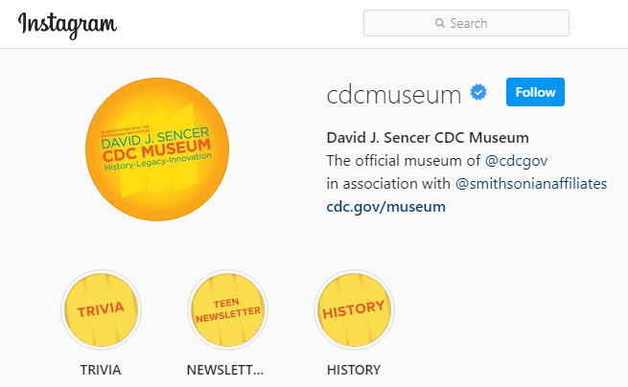
Give it a Try
3. Share Your Findings
Instagram @CDCmuseum
Notes:
Share Your Findings
The David J. Sencer CDC Museum uses award-winning exhibits and innovative programming to educate visitors about the value of public health and presents the rich heritage and vast accomplishments of CDC. Your demonstration could be a valuable contribution! Share your demonstration with the CDC Museum on Instagram using @CDCmuseum.

Slide 16

Questions?

